Slide 1



De-institutionalization and Family
Reunification Initiatives in Odisha, India
Rajendra Meher
Convener, Taskforce, India
Every child has a Right to Family

Slide 2
Focus of presentation
About Taskforce
Institutional care in India
About the Children in Institutional care
Pilot project on De-institutionalisation
Steps & key process
Achievements
Challenges & Opportunities
Way forward plan

Slide 3
About Taskforce
Taskforce is a body of civil society organizations;
-- aims to contribute to preventing and reducing the phenomenon of institutionalization of children by systematically supporting the children and care givers
--Sensitize and influence the policy makers including government functionaries, elected members and civil society on the subject of Non institutional /family focused child care system

Slide 4
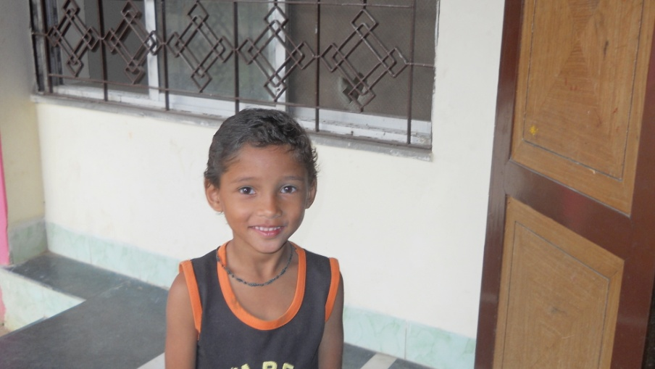
Institutions in India are…
Thousands of children in need of care and protection or in conflict with law live in institutions
No accurate data available on the number of child care institutions exist in
the Country or the number of
institutionalized children
Child care institutions are
licensed under multiple
acts – Juvenile Justice Act (JJ Act), Women and
Children’s Institutions Licensing
Act, Orphanages and other
Charitable Homes Act, etc.

Slide 5
Institutions in India are…
Institutions run by NGOs, Faith based organizations and Governments
Study shows that only around 30% institutions are recognized by Government
Percentage of children having biological parents residing in the institutions is very high (no accurate data available)
Standards of care in institutions is a serious concern and always an issue

Slide 6
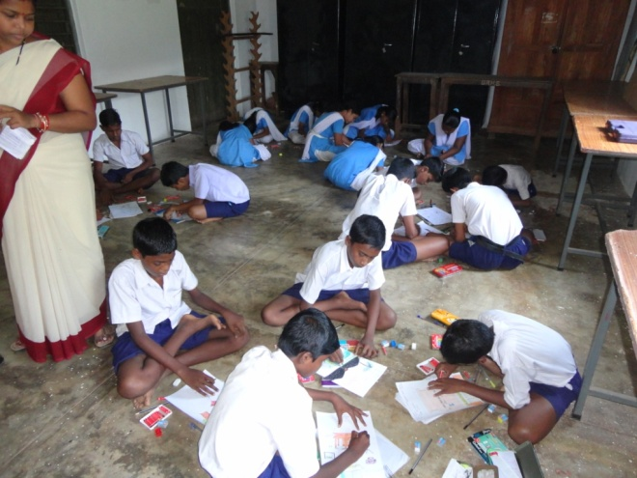
Children in Institutions are…
  Orphans, abandoned and
  destitute
  Missing and run-away
  Street and working children
  In conflict with the law
  Rescued from being trafficked
  Abused, tortured and exploited
  Affected by HIV/AIDS
  Affected by natural and man-made calamities and other emergencies
  Disabled and lacking parental care
  Suffering from terminal/incurable diseases
Notes:
Multiple children with a multiplicity of needs
Life experiences at the point of contact with the JJ System has likely included a great deal of stress, trauma and even violence

Slide 7
Rational
Research evidence demonstrating that child in institutional care has negative effect on the holistic development.
A better understanding of the negative effects of institutions upon children by policy makers and cost to the State and local authorities.
Greater insights into how foster families could be encouraged to provide a better alternative care placement.

Slide 8
Big Questions
?
Under what conditions do these thousands of children live?
Whose responsibility are they?
What are their rights and entitlements?
Who will safeguard their rights?

Slide 9
Present Arrangements
We have a very promising Schemes (Integrated Child Protection Schemes) where Government wants to implement various family focused care arrangements
For the first time Government recognize family focused Non institutionalized child care through various reform approaches and schemes.
Institutionalization will be treated as the last resort ( as per the schemes)

Slide 10
Role of Taskforce
Implement various Alternative care arrangement and established the concept
Undertake process documentation
Invite Government to visit the programme and see how things is happening
Mobilize media and local opinion makers about the programme
Trained various stakeholders on the concept
Put trained Social worker in all child care institutions to carry out the programme

Slide 11
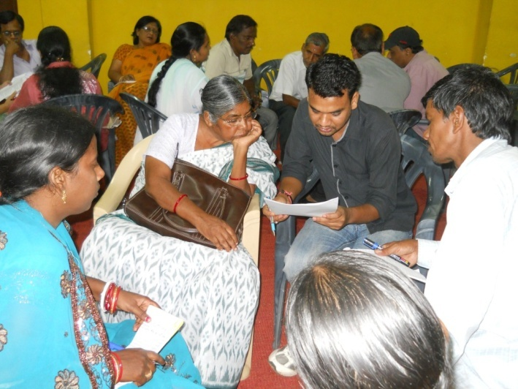
Task Force in Piloting the concept of family reunification.
Taskforce is presently working on the project of de-institutionalization, for the Women & Child Development Department of Odisha, with support from Ministry of Women & Child Development and in technical support from UNICEF
Under this Pilot initiative Taskforce
is working closely with six nos.
of child care institutions (Balashram,
Govt. owned) in six different
geographical representative regions
with diverse traditional, cultural and
livelihood practices.

Slide 12
Children in the piloted institutions
Profiles of the children, residing in the piloted institutions.
Total no of children residing 712, out of which 535 are boys and 173 are girls.
Out of total no of children 70% of children have lost one parent, 17 % children are orphan and 13% of the children have parents, who are living in extreme poverty..(99% of the children are from BPL* families)
Out of total no of children with single parents, around 35% of the child having single mother.

Slide 13
Key focus of Interventions
1. Strengthen capacity of families to cope with their problems and to create an enabling family environment for children
2. Stimulate and strengthen community-based responses to reduce dependence on institutions
3. Ensure governments’ Safety Net/ social security programs of the targeted families
4. Facilitate setting strong gate keeping mechanism in district level so as to avoid unnecessary institutionalization of children
5. Build capacity of various stakeholders on the concept of de-institutionalisation and family reunification.

Slide 14
Steps for De-institutionalization
Preparatory Phase
Activities
Conceptualization workshop with identified child care instititutions and other key stakeholders. Organise Prospective building workshop among the key functionaries of the institutions
Outcomes
Conceptual clarity and a plan of action developed among child care institutions and other key stakeholders .
Intervention Phase
Outcomes
Home study report of each individual child along with socio economic profile of family prepared. Initiate counseling services and consensus buildup.Re-integration of children accelerated.
Follow up and Monitoring Phase
Activities
Child tracking system developed along with monitoring at different level
outcomes
Support to the family and children to continue his education and a healthy childhood in their families
Activities
Identify/mapping of children and potential parents and extended family. counselling of parents and children

Slide 15
Interventions at various level
At Institution level
Developed criteria' to select children and take consent of the child coming under the criteria'
Preparation of Individual care plan (ICP) for the child.
At the village level
Home study report preparation
Admitting the child to a village level educational institution to continue their studies.
At the District level.
Prospective building workshop with the key stakeholders.
CWC( child welfare committee) facilitation of the deinstitutionalization process
Back Home Ceremony at the village level
follow up of child's status at the village by the task force.
Discussion /counselling with the parents and relatives
Counseling the children by the social worker

Slide 16
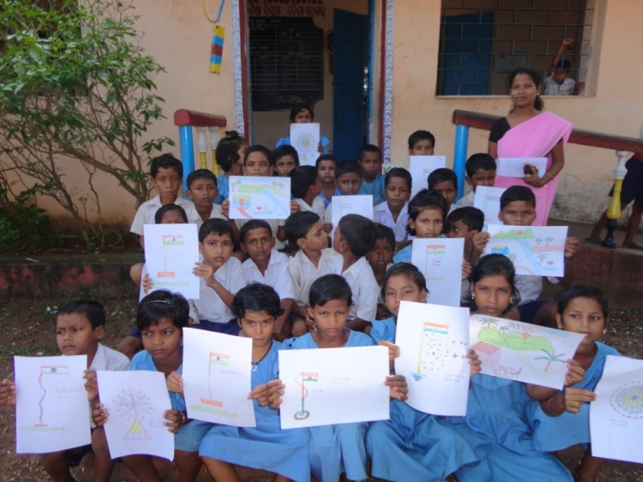
Achievements – First year
As a result of the interventions 90 children have back to their community and family
37 children who are from extremely poor families are supported with SPONSERSHIP of Rs 1000/- per month per child from Government.
All the children are enrolled in
the nearest school and
continuing education .
Vulnerabilities mapping of children
residing in the institutions and
work out strategies for social
reintegration initiated.
Government is planning to develop a Gate keeping mechanism and announced a Sponsorship programme for the families

Slide 17
Implementation mechanism
Work closely with Child Welfare Committee (CWCs) and District Child Protection Society, (DCPS) in the district and Orissa State Child Protection Society (OSCPS) in the state
Establish link with various social protection schemes/programme as a part of family strengthening program.
Identify other orphan and vulnerable children in the society and link them with various schemes to prevent institutionalization.

Slide 18
Challenges
Everybody is tuned towards institutionalization of children, awareness about family focused care is extremely poor
Inadequate Gate keeping mechanism to prevent unnecessary institutionalization
Peoples‘ perception towards Child care institutions are different. They consider it as a hostel/Education institute/Business
Mostly Parents are resource poor and unable to arrange other facilities for children to stay in the house.

Slide 19
Opportunities
ICPS Schemes which subscribe the family focused care arrangements are in placed
JJAct focusing on rehabilitation and reintegration of children in need of care and protection is in force
Resource allocation by Government is started under this concept
Slowly alternative/ non-institutional care concept getting recognition by people.

Slide 20
Way forward
Share the learning with Larger stakeholders and scale up to reach more number of Children/institutions
Undertake study on Status of Institutions offering Institutional care
Develop a strong Gate keeping mechanism and advocate /lobby for De-institutionalization.
Study on Aftercare approach and pilot the concept
Develop a convergence mechanism /synergy with various welfare schemes meant for families and their children

Slide 21



Thanks
Women and Child Development Departments, Government of Odisha
Unicef, State office for Odisha
Special thanks to
Kinderpostzegels
Cordaid
Bep Van Sloten, BCN

